Slide 1
Health and Life Insurance
Business System
TS SDP – 1 Project (Review 0) Batch No - 303

Slide 2
Our domain – Health and life insurance

Slide 3

|My Team
2000031291 - Chitturi Sailesh (lead)
2000031377 - Thatishetty Aakash Chandra
2000031662 – Karthikeyan Varaha Raj Sai

Slide 4

What is Health and Life Insurance?
Life insurance is mainly protecting your family/beneficiary/nominee financially in the eventuality of the insured's demise
Health insurance is the protection cover for self as well as the family .
In order to avoid any unfortunate eventuality such as loss of life due to financial constraints.

Slide 5

How Health and Life Insurance works?
A life insurance policy is a contract between the policyholder and the insurance company.
With the promise that the insurer will pay a pre-decided amount to the nominee.
On the condition that the policyholder pays all the premiums without fail.

Slide 6
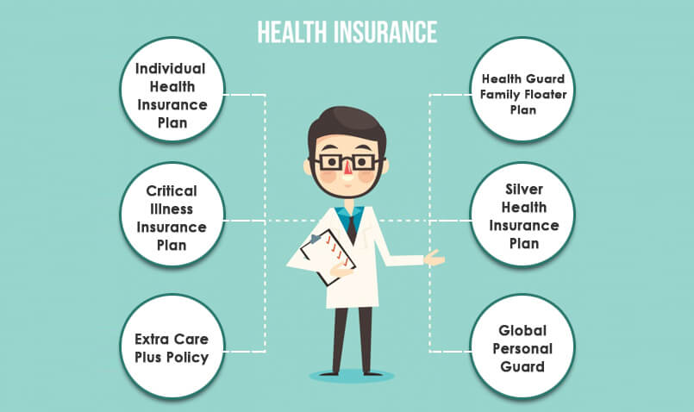
What are the four types of health insurance?
6 TYPES OF HEALTH INSURANCE PLAN
Preferred provider organization (PPO) plan.
Health maintenance organization (HMO) plan.
Health savings account (HSA)-qualified plan.
Indemnity plans.

Slide 7
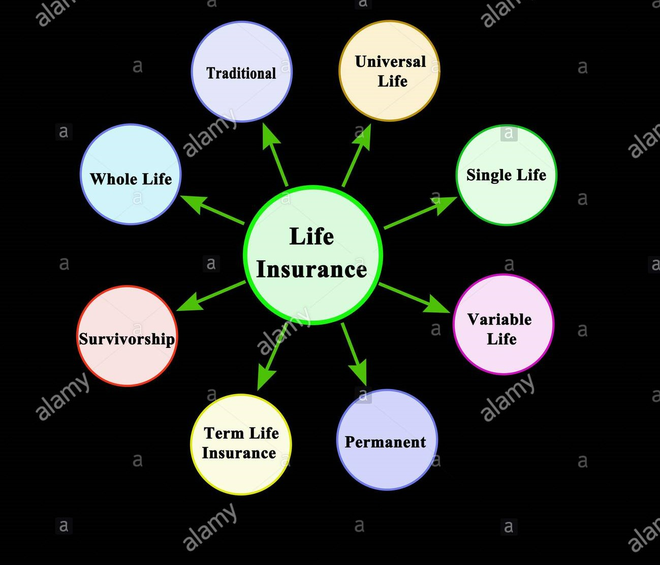
What are the main elements of life insurance?
A life insurance policy has two main components—a death benefit and a premium.
Term life insurance has these two components, but permanent or whole
life insurance policies also have a cash value component.

Slide 8

What are the benefits of Insurance?
It protects your income from unexpected expenses.
It protects the money you're saving for future plans.
It gives you the power to protect your family even when you're not around anymore. ...
It protects your emotional health by giving you peace of mind.

Slide 9







Survey Results

Slide 10
Interview (Survey Questions)
Which Insurance Is Important For You People ?
Do you Apply For Any Insurane Policies Before?
What type of insurance you Applied For ?
Did You Claim Any Of Them , And How Much It Covered
Do You Think Health and Life Insurance Will Help Actually?

Slide 11
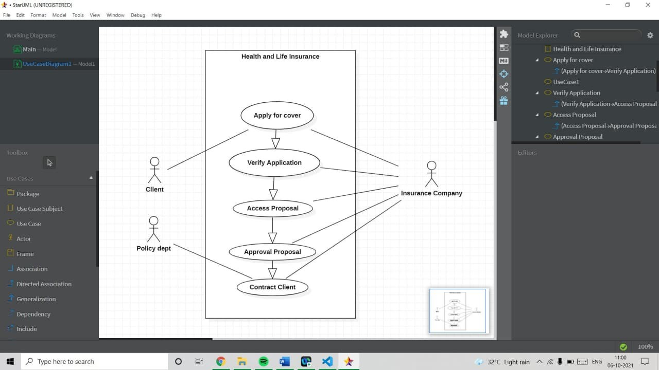
User Application

Slide 12

User Persona

Slide 13
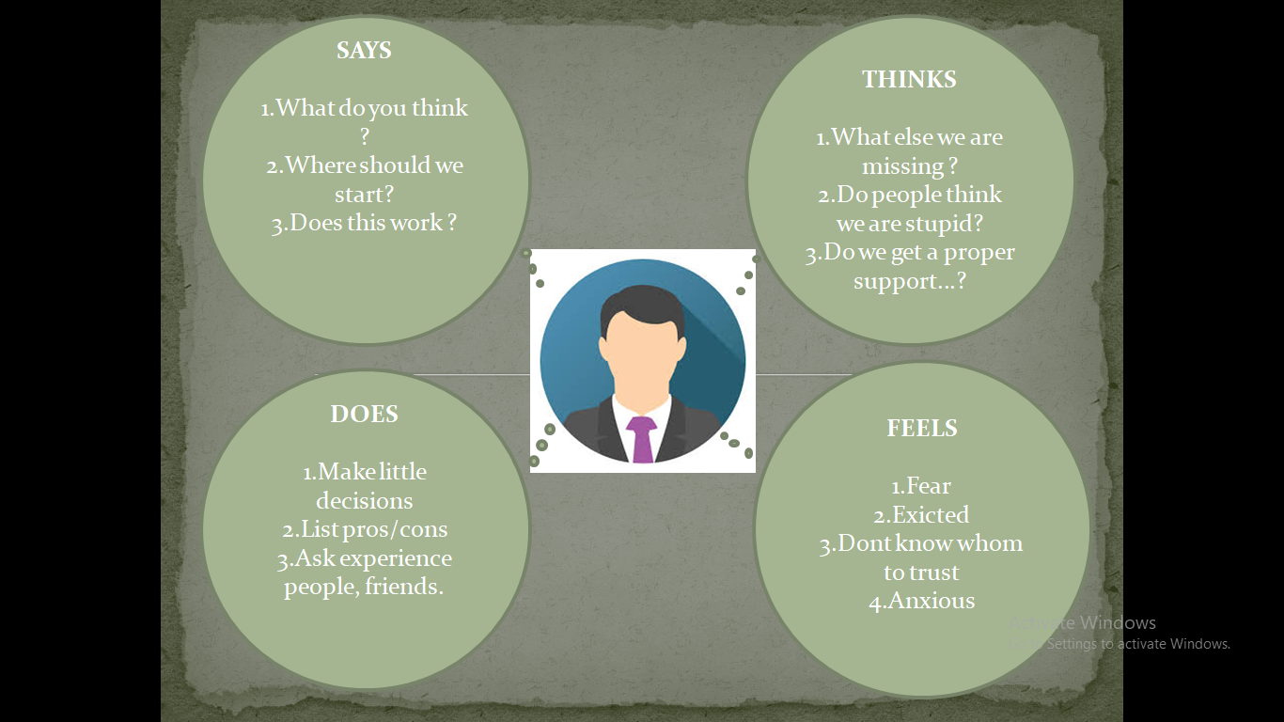
Empathy Research

Slide 14
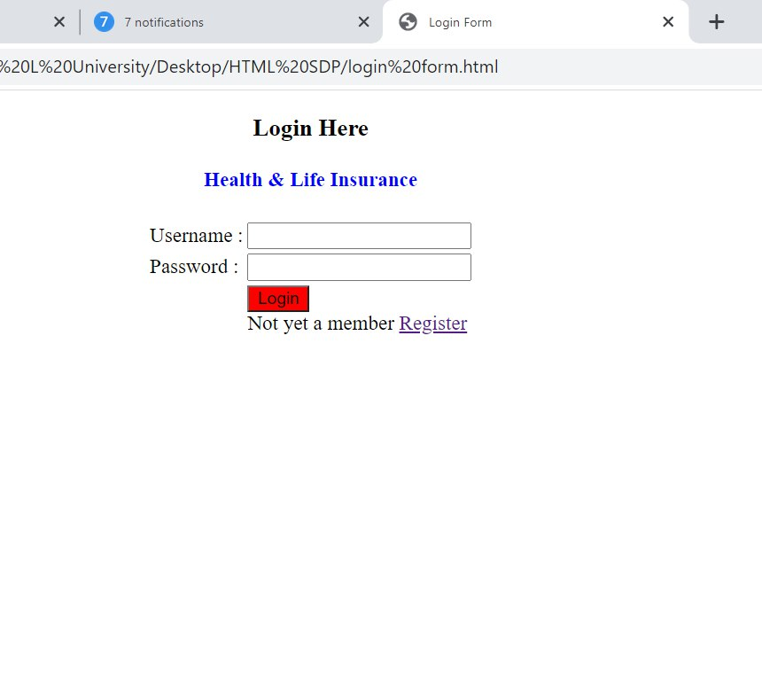
First Look of website Pretotype Login Page

